Slide 1
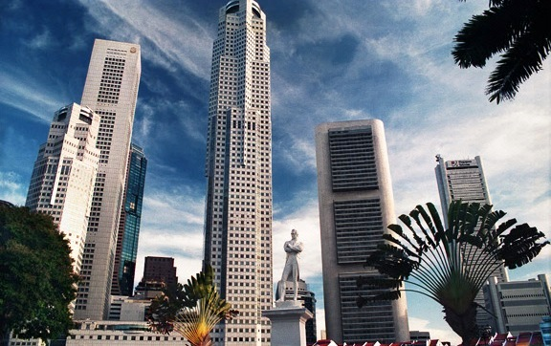
GES1009/SSA2203
Dr. Brunero
SG’s Business History :
Continuity and Change?

Slide 2
For reflection:
Is there value in understanding the larger implications of certain events/govt. policies on Singapore’s economy and society?
How can we think about the characteristics of business environment in different eras?
How can we use the ideas of ‘continuity and change’ to understand Singapore’s business history?

Slide 3
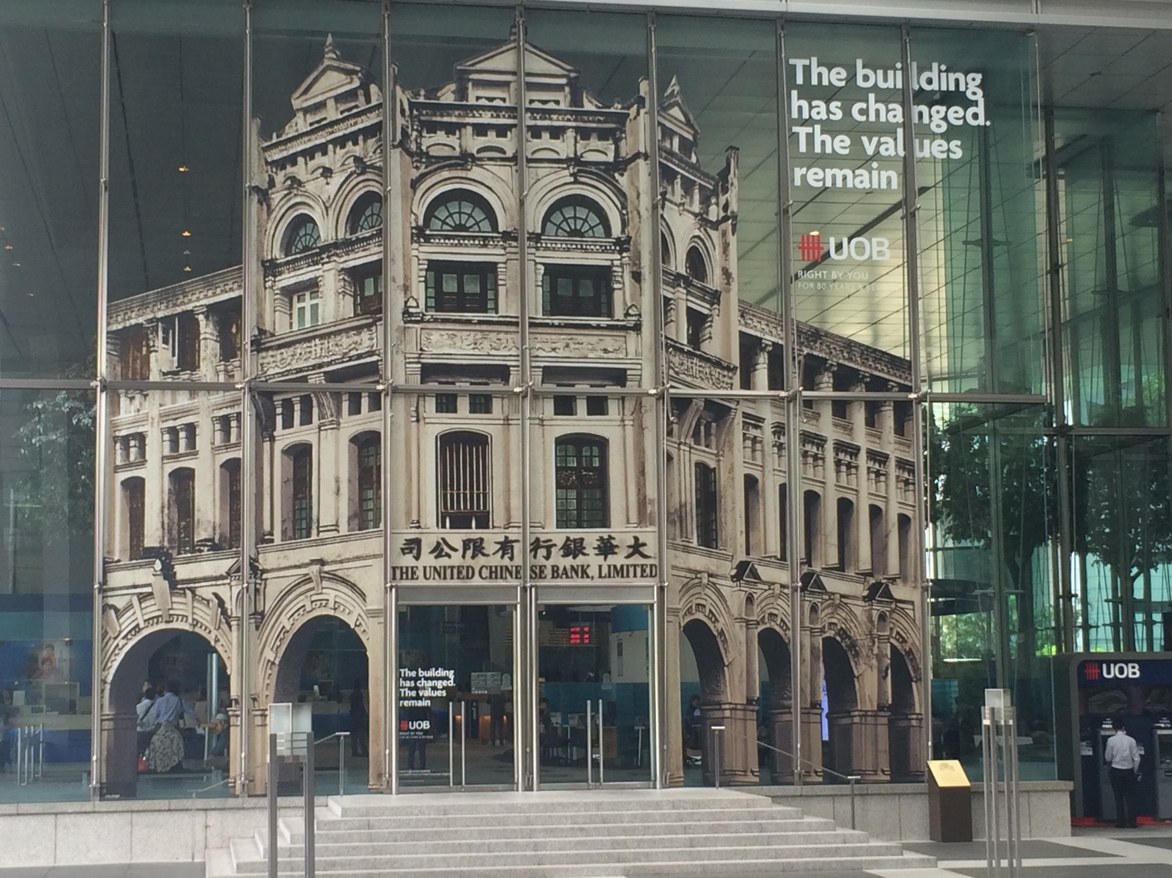

Slide 4
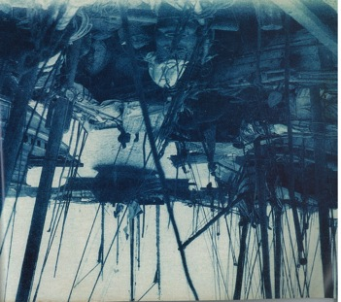
TRADE: TEMASEK
Trading emporium tapping into regional trade and the China trade
Gateway for goods of the Riau Archipelago and South Johor hinterland and the Indian Ocean. Southeast Asian and Chinese products were also traded at the port.

Slide 5
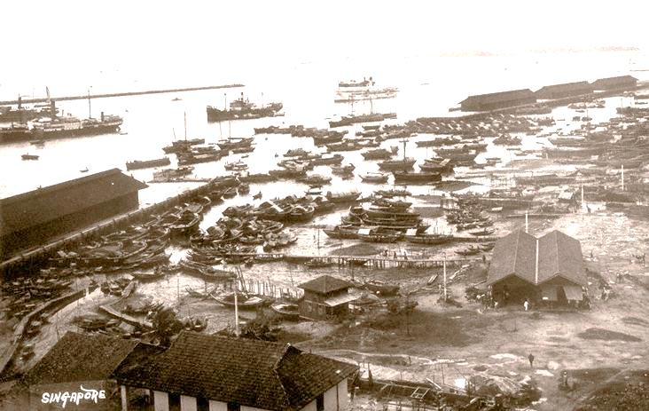
TRADE: Singapore as a colonial entrepôt
Patterns of trade
Commodities
Communities
The characteristics of a colonial port city
NEW??? OR a revival of trade?

Slide 6
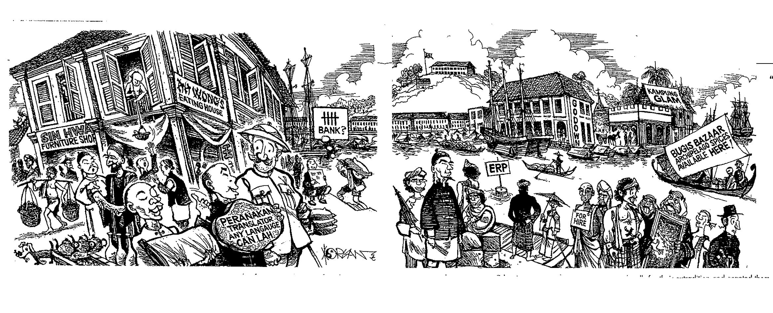

Slide 7
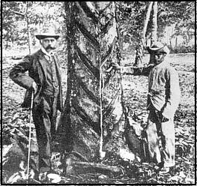
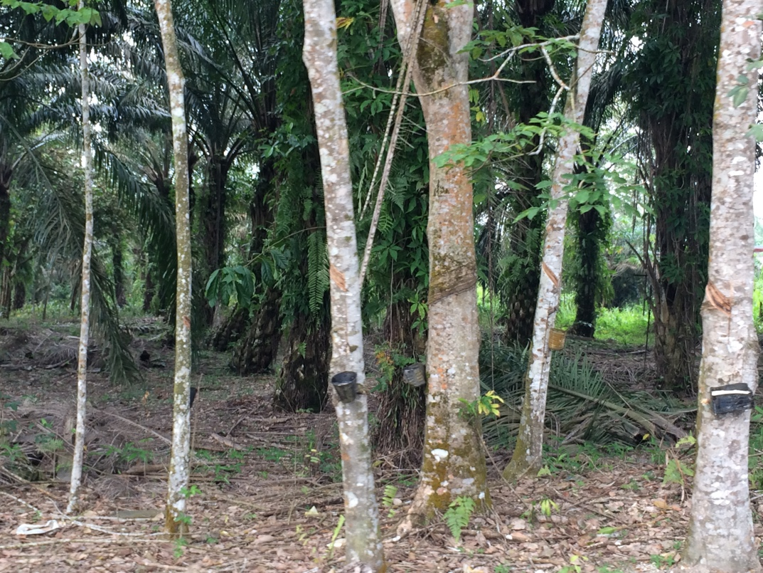
Tin and Rubber

Slide 8
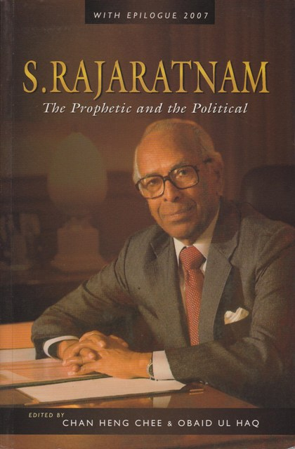
S. Rajaratnam, Feb 1972
Delivered a speech dealing with Singapore’s future as an Ecumenopolis, a‘world-embracing city’.
A city that operated on a global stage, not just regionally.
Technology and financial services as some of the key features of these ‘global cities’.

Slide 9

Nation-state or Global city?
Globalization raises issues of the need to BALANCE between regional and international forces.
How successful has Singapore been in balancing these forces?
A space of flows: Defining Singapore
Reconciling the national narrative and the global city ethos
By Adrian W. J. Kuah FOR THE STRAITS TIMES
20/10/2012

Slide 10
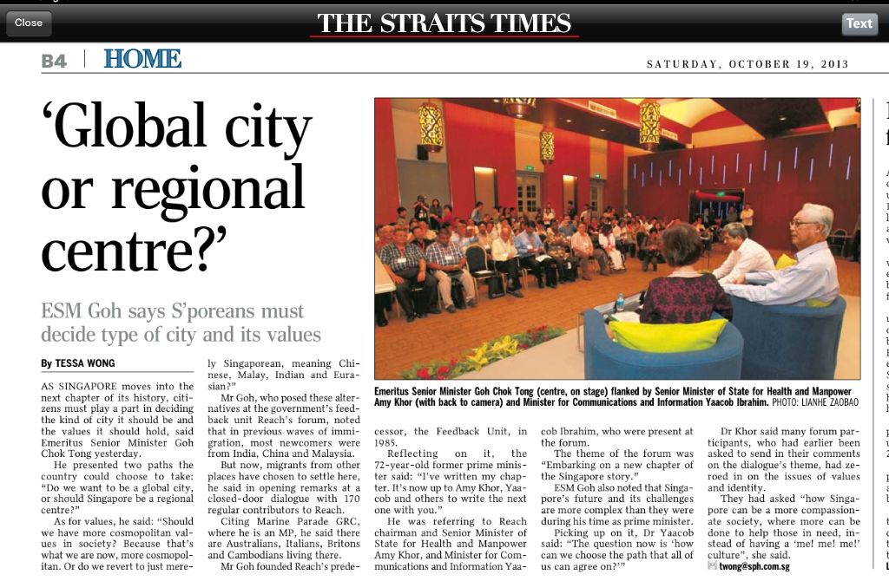
The discussion on Global vs regional continues…

Slide 11
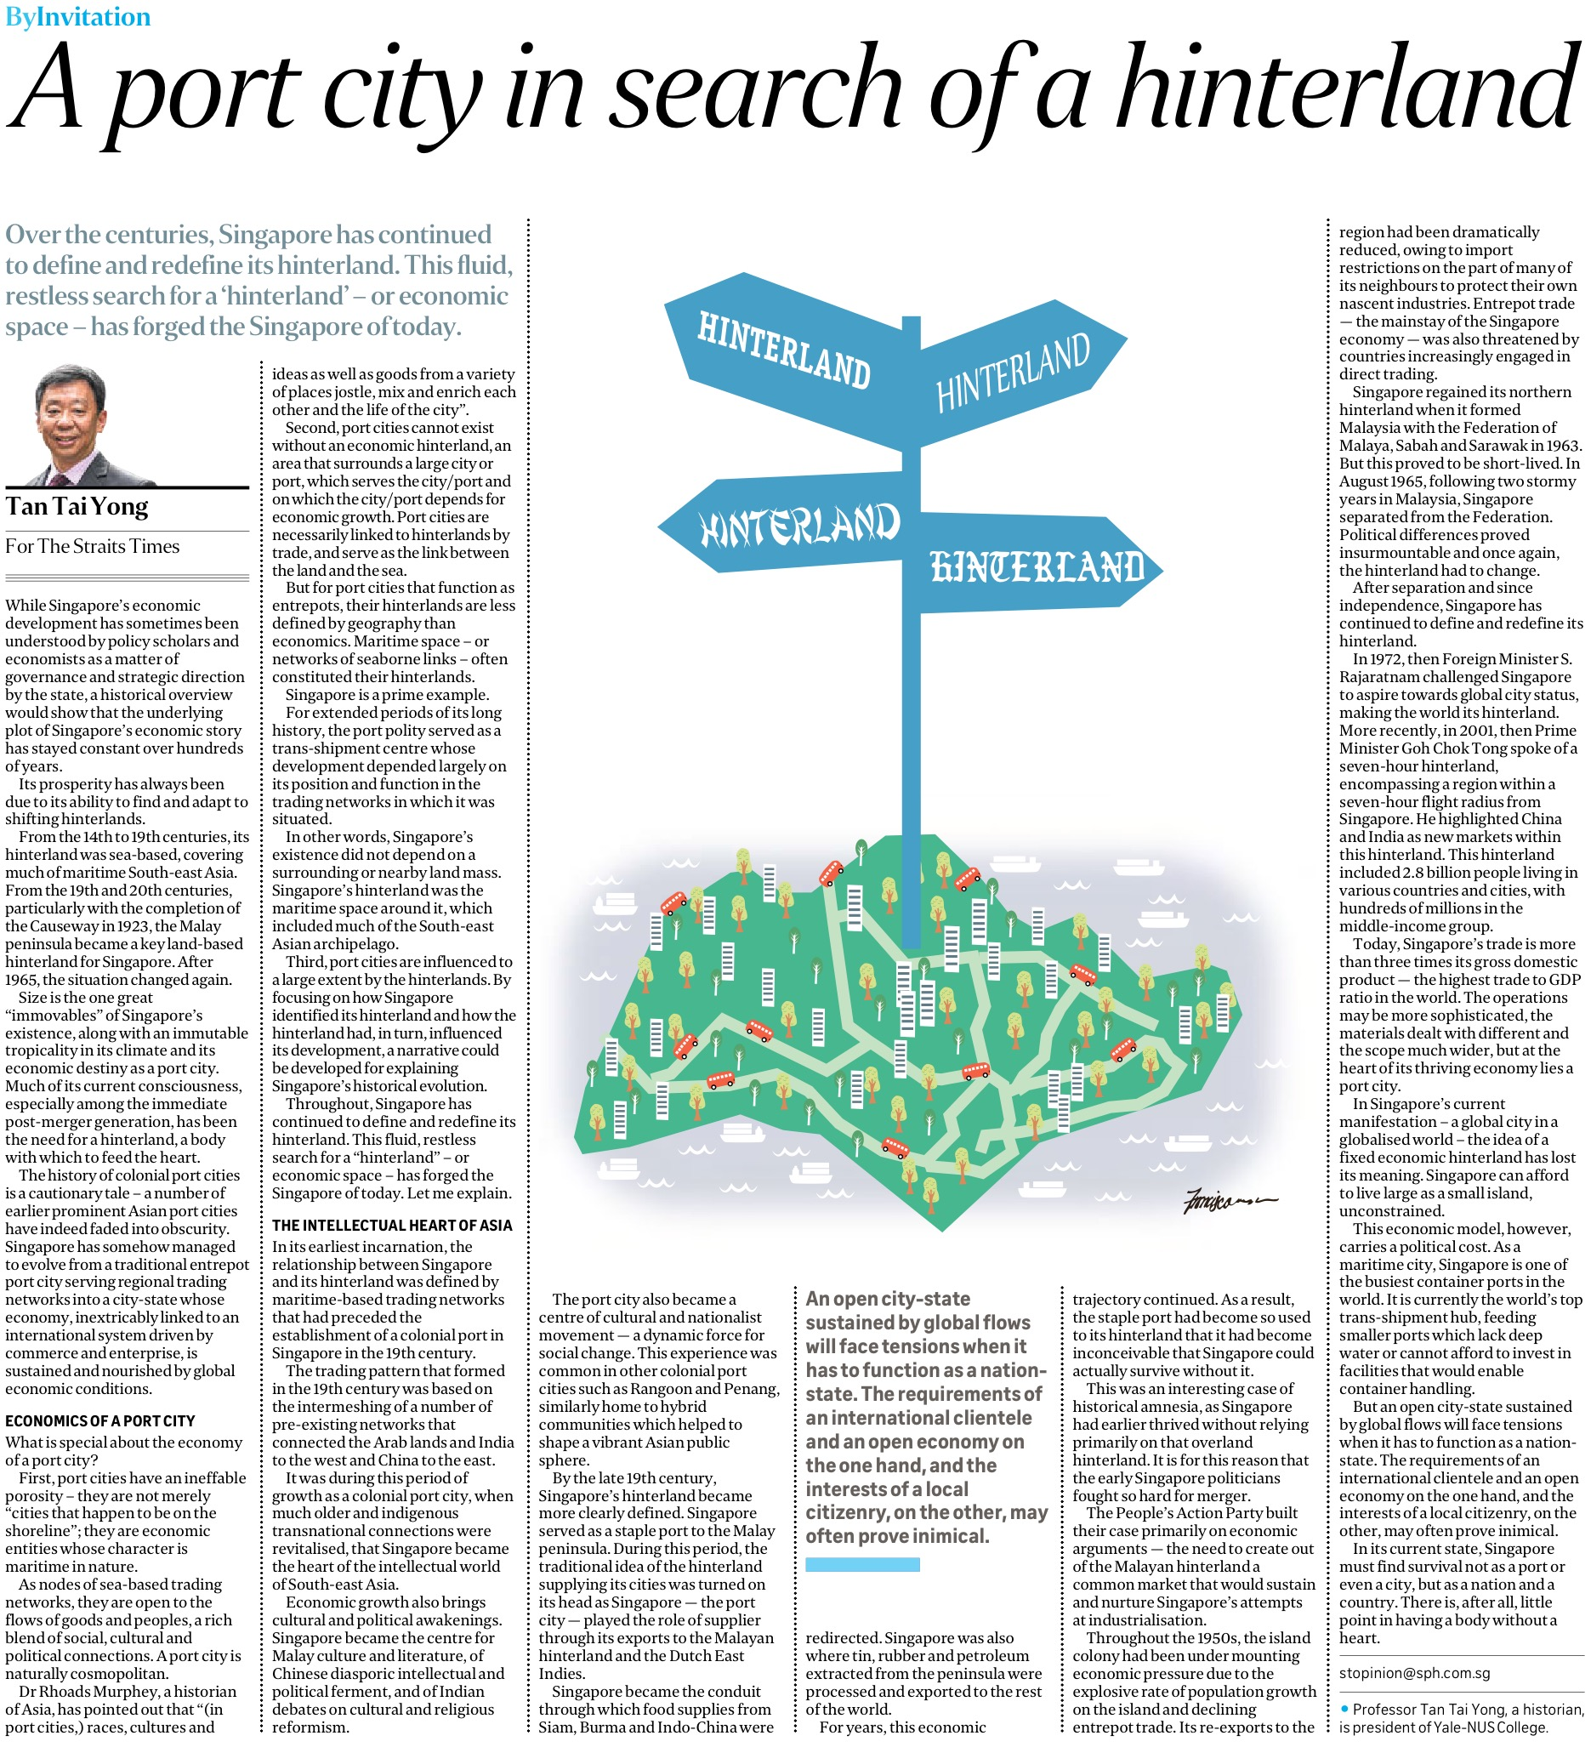
The Straits Times, 2 April 2019

Slide 12
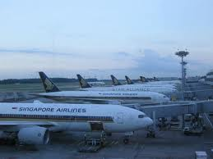
Singapore- early NATIONHOOD- regional hub for finance, shipping, air…and aspiring to be a global city?
Singapore-NATION- HUB for shipping, air, finance, science and tech? Aspiring KBE? Or GLOBAL CITY?

Slide 13
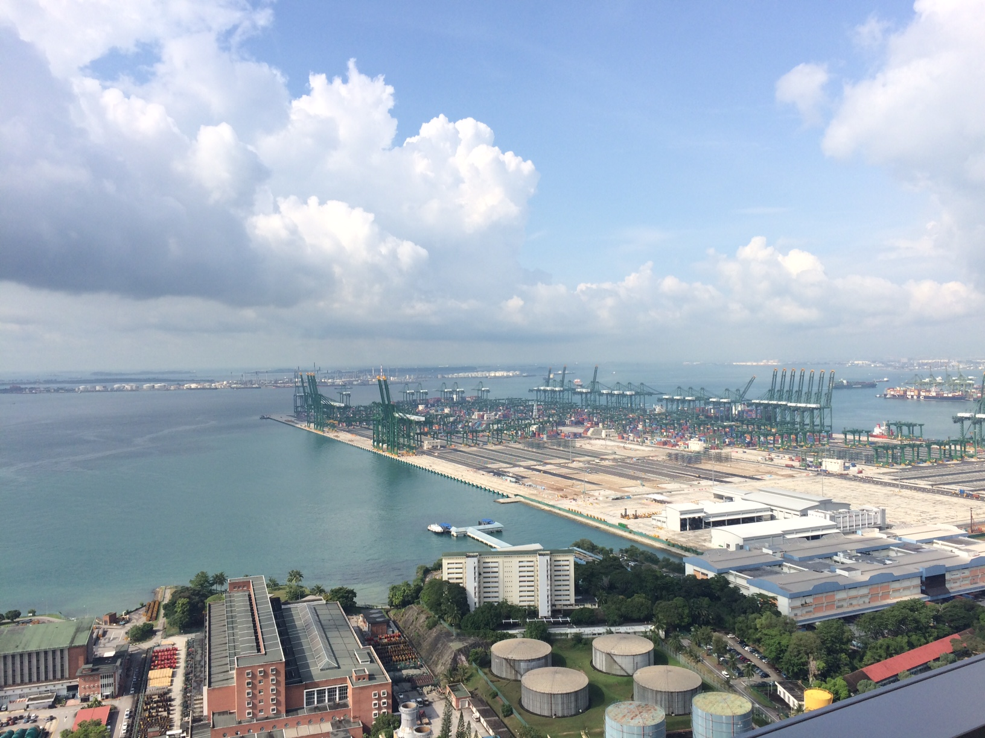

Slide 14
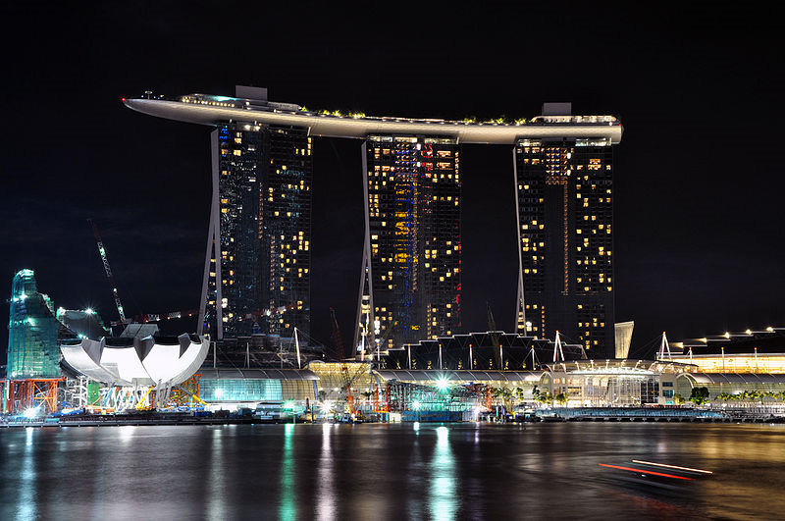
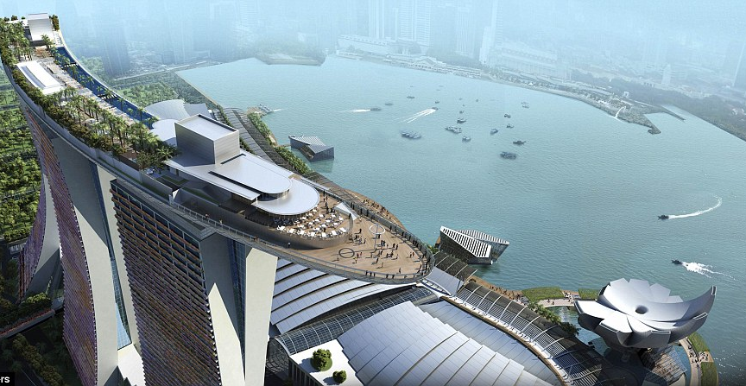

Slide 15

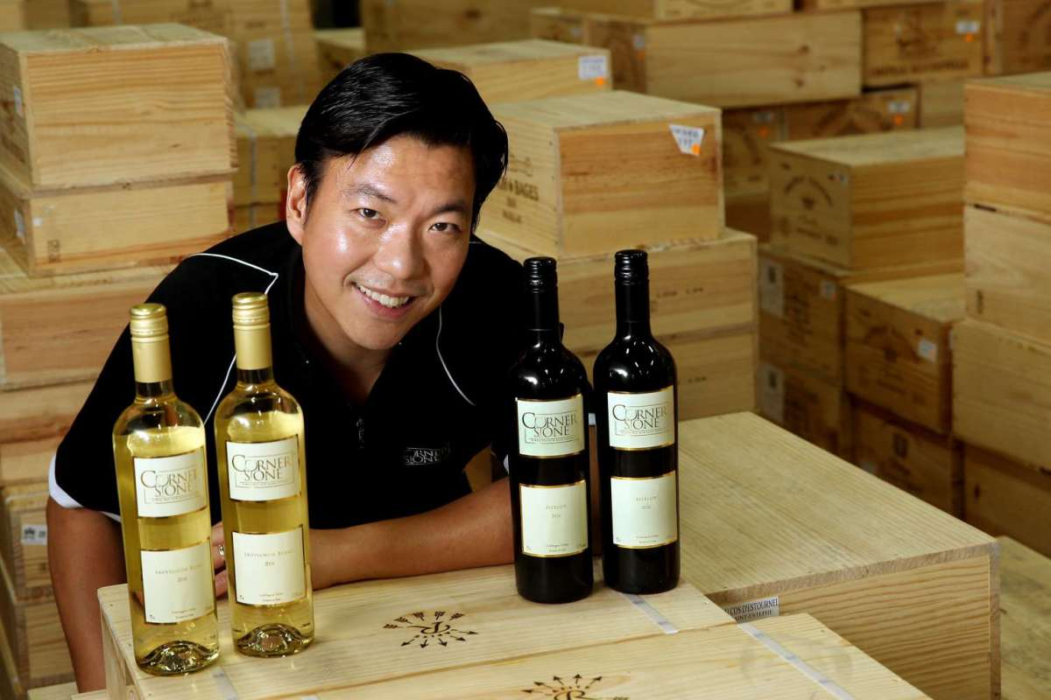
Change?
Increased interest in Heritage branding
‘Disruptors’ and new business approaches?
Rebranding to reach new markets?
http://www.straitstimes.com/singapore/old-wine-in-new-bottles
Cornerstone wines– (formerly Hock Tong Bee)

Slide 16
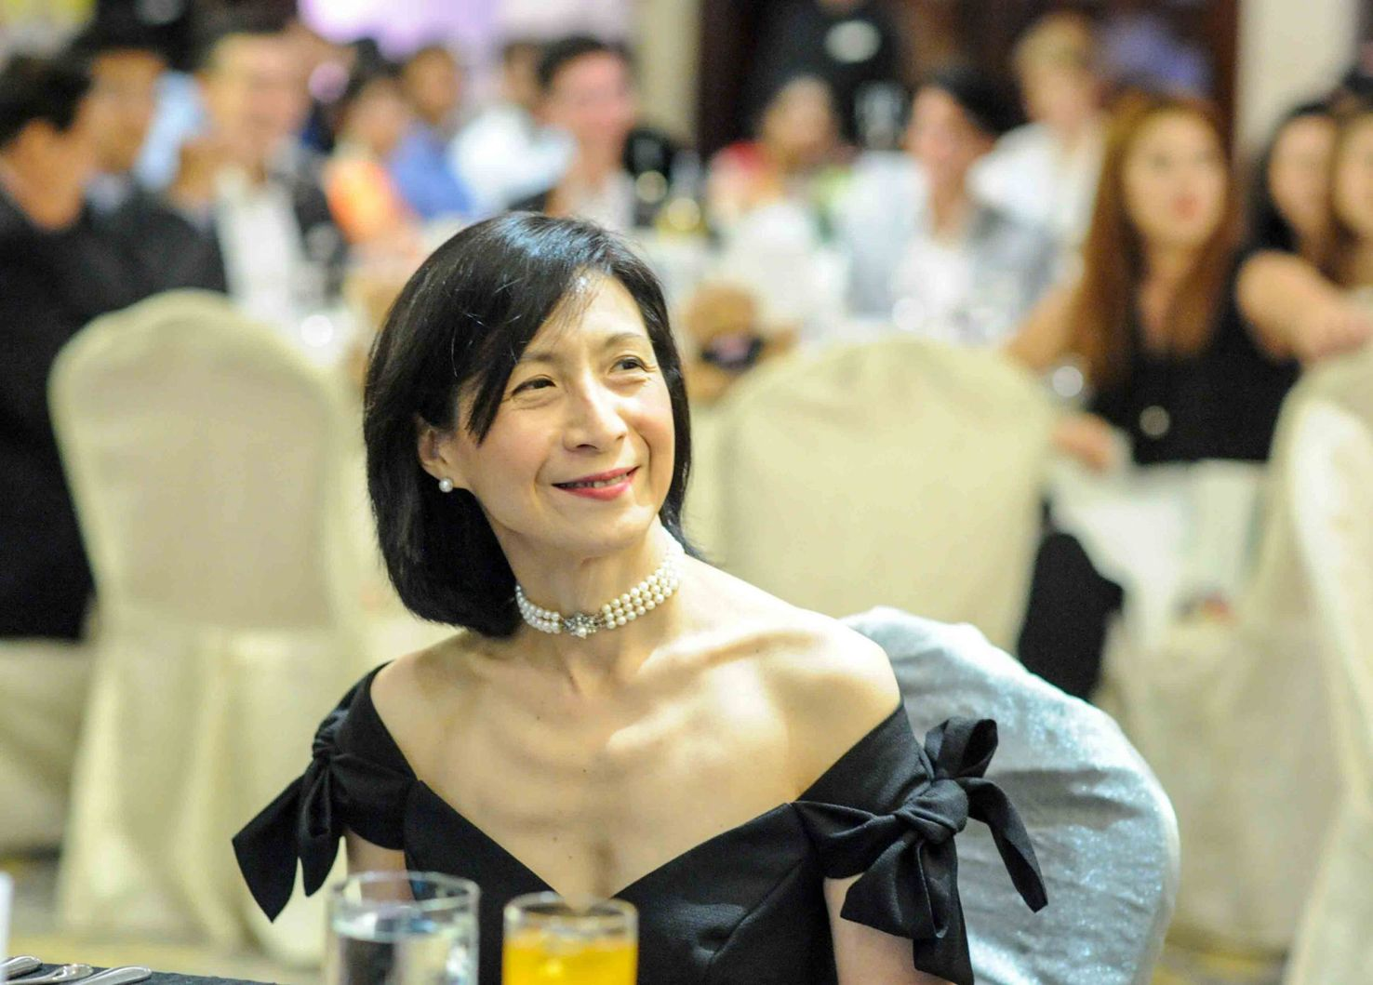
Change?
Chew Gek Khim
Family business?
Entrepreneurship?
Networks?
Executive chairperson of Straits Trading Company
Assumed control of the family business in 2008 and transforming it into a modern firm.
SG Tatler “10 women who are shaping Singapore 2018”
https://sg.asiatatler.com/life/ten-women-shaping-singapore

Slide 17
Summing up:
Global trade and a multi-ethnic society is not a new development in Singapore’s history.
The port remains a significant aspect of Singapore’s business/economy and identity.
Tracing the ideas of ‘continuity and change’ can help us to better understand Singapore’s business history.

